Slide 1
Shape Poems

Slide 2
Aim
To understand the features of shape poetry.
Success Criteria
I know that a shape poem describes an object, person or animal and the words of the poem form the shape of the object, person or animal being described.
I understand that shape poetry doesn’t have to rhyme.
I can try to include alliteration and similes in my poem.
I can create my own shape poem.

Slide 3
Shape Poems
Can you guess what these poems are describing?
They glide across
the golden grass
gathering goblins and
gathering grasshoppers.
They giggle as they
glide above
the ground.
Hint: You can use the words and the shape of the words to help you.

Slide 4
Shape Poems
Can you guess what these poems are describing?
Hint: You can use the words and the shape of the words to help you.
Softly, it falls silently from the sky.
It is so silvery, small and sudden.
Slowly you slip and slide as you sled
your way through its silky secrets.

Slide 5
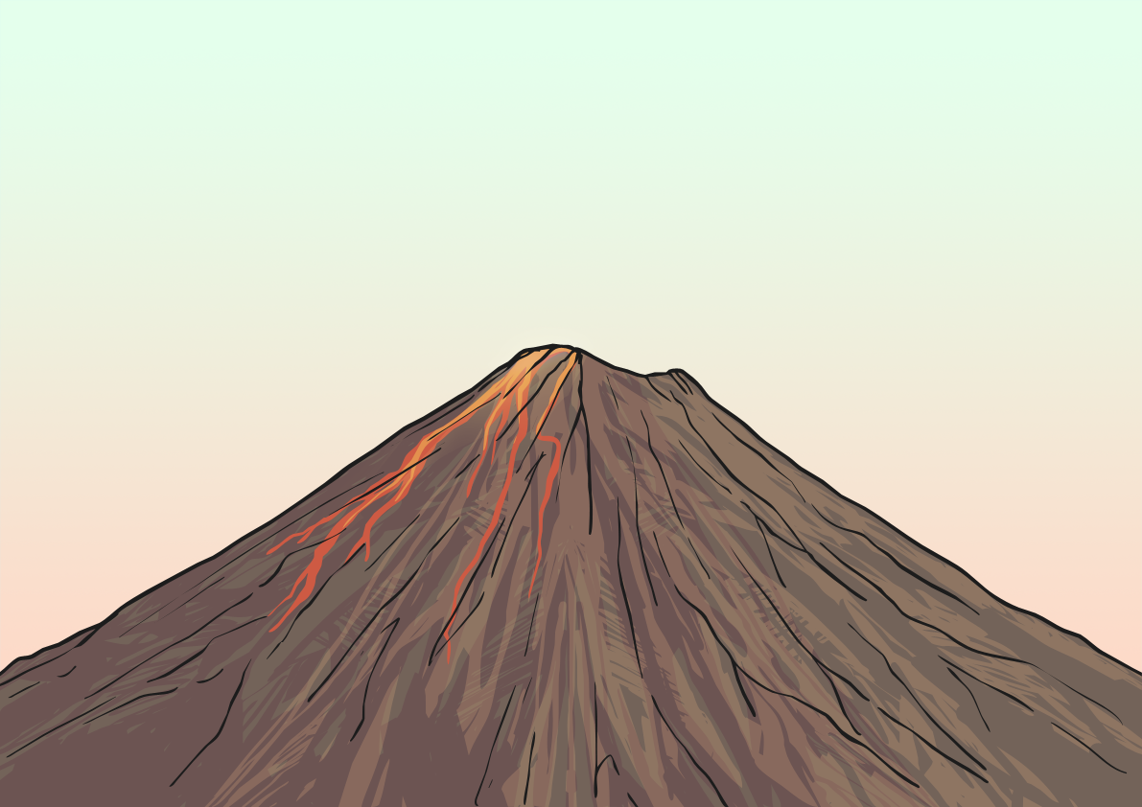
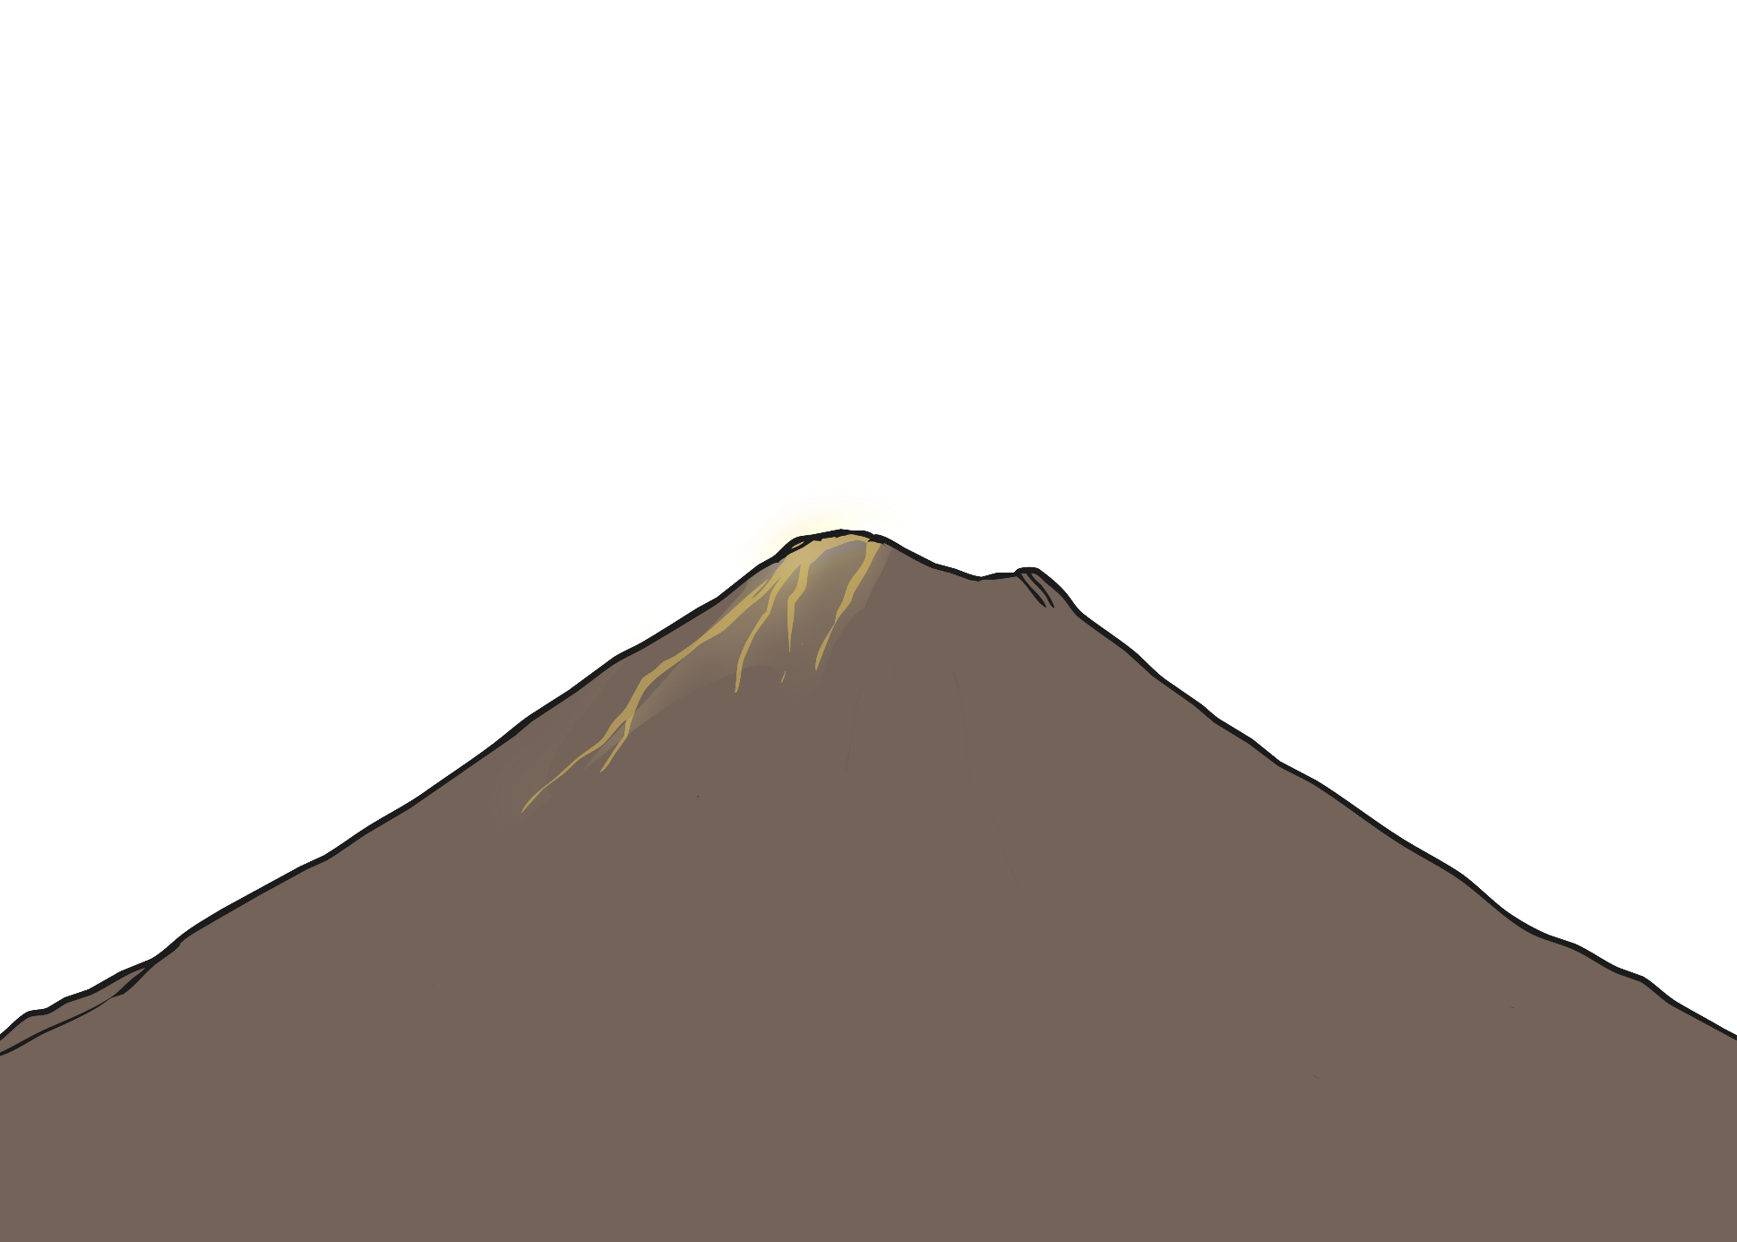
Shape Poems
Can you guess what these poems are describing?
Hint: You can use the words and the shape of the words to help you.
A huge rock that
rumbles and roars, wrecking the
ground all around it. It shoots sizzling, steaming, scorching lava like a monster spitting out hot liquid into the air. Like a smoking dragon, it finally starts to calm down. The chaos stops and it goes back to being a deadly and dangerous rock.

Slide 6
What is a Shape Poem?
A shape poem is a poem that describes an object, person or animal.
The special thing about a shape poem is that the words of the poem form the shape of the object, person or animal being described.
Shape poems don’t have to rhyme!
Shape poems can use full stops and capital letters like sentences.
Shape poems often use alliteration or similes.

Slide 7
The Features of a Shape Poem
What did you notice about the shape poems we looked at?
Each line can be a different length or be curved to form the shape of the object that is being described.
Full stops and capital letters are used just like you would use in sentences.
A huge rock that
rumbles and roars, wrecking the
ground all around it. It shoots sizzling, steaming, scorching lava like a monster spitting out hot liquid into the air. Like a smoking dragon, it finally starts to calm down. The chaos stops and it goes back to being a deadly and dangerous rock.
A huge rock that
rumbles and roars, wrecking the
ground all around it. It shoots sizzling, steaming, scorching lava like a monster spitting out hot liquid into the air. Like a smoking dragon, it finally starts to calm down. The chaos stops and it goes back to being a deadly and dangerous rock.
A huge rock that
rumbles and roars, wrecking the
ground all around it. It shoots sizzling, steaming, scorching lava like a monster spitting out hot liquid into the air. Like a smoking dragon, it finally starts to calm down. The chaos stops and it goes back to being a deadly and dangerous rock.
Alliteration can be used – this is lots of words in a row beginning with the same letter.
Similes can be used – this is where we use the words ‘like’ or ‘as’ to compare two things to each other.
The lines don’t have to rhyme.

Slide 8
Let’s Try it!
First, let’s choose something to describe. Let’s choose… An ice cream!
Next, we need to brainstorm all the adjectives or phrases we can think of to describe an ice cream…
cold
a gooey mountain
Can you think of any more?
delicious
with sprinkles like jewels
melting and dripping
different flavours
sauce dripping like lava

Slide 9
Let’s Try it!
Here are some lines written using the adjectives and phrases that we brainstormed. Oh no, they’re all mixed up! Can you put them into the right order to make the shape of an ice cream? Use the length of the lines and the punctuation to help you.
Lick!
a thousand
coloured jewels
glistening in the sun,
swept aside to dance and waltz on my tongue
Strawberry sauce oozes like lava down
swept aside to dance and waltz on my tongue
Strawberry sauce oozes like lava down
sweet slopes.
A mountain
sweet slopes.
A mountain
Lick!
a thousand
down…
down…
melting,
falling
melting,
falling
down…
down…
coloured jewels
glistening in the sun,
Click here for the answers
down.
Lick!
Ah!
down.
Lick!
Ah!

Slide 10
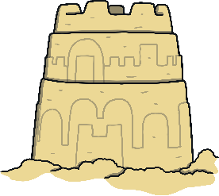
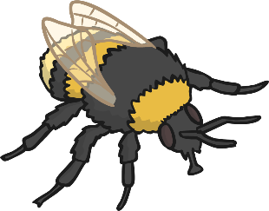
It’s Your Turn to Brainstorm
Let’s make a shape poem describing objects or animals!
bucket and spade
reaching for the sky
dancing in the wind
sloppy, sticky sand
sandcastle
sunflower
as yellow as a banana
tall turrets
falling down with the sea
large, brown bed
shining brightly
as stripy as a tiger
looking over the world
whizzing around the flowers
Click here for the answers
as bright as a star
bee
the Sun
buzzing
far, far away

Slide 11
It’s Your Turn to Write a Shape Poem
Now, choose one object or animal.
Using the ideas you brainstormed and an outline of the object or create your shape poem.
Remember to stay inside the lines of the picture, starting a new line when you get close to the edge.
Don’t forget to use full stops and capital letters.
Try to use alliteration or similes if you can. This will make your shape poem more exciting and descriptive.

Slide 12
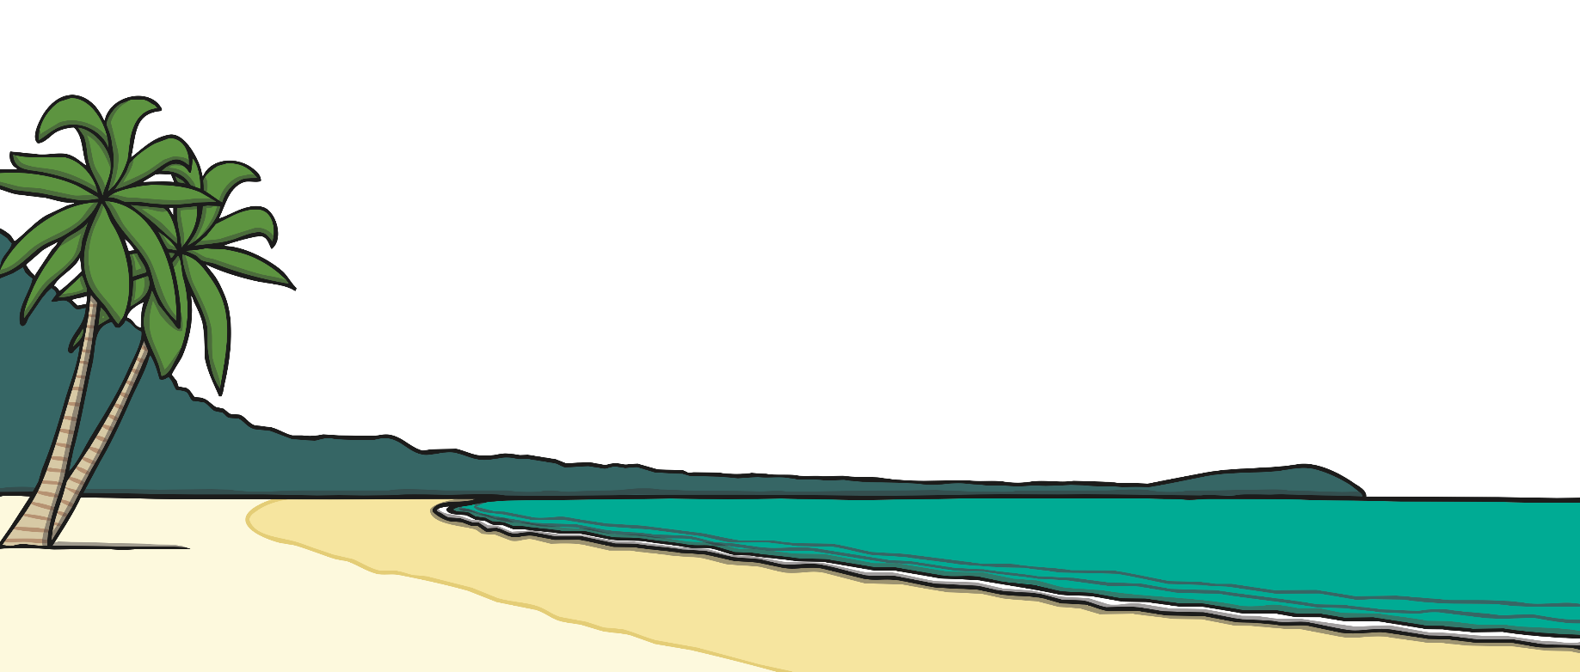
Plenary
Tell me a fantastic adjective that you have used in your shape poem.
Who can read out an example of where they have used alliteration?
Who has used a simile? What have you compared?

