Slide 1
Places around the world
By Louis Jewell

Slide 2
Niagara falls
Niagara Falls, Ontario, is a Canadian city at the famous waterfalls of the same name, linked with the U.S. by the Rainbow Bridge. Its site on the Niagara River's western shore overlooks the Horseshoe Falls, the cascades' most expansive section. Elevators take visitors to a lower, wetter vantage point behind the falls. A cliff side park features a promenade alongside 520-ft.-high Skylon Tower with an observation deck.

Slide 3
Niagara falls
.30 million people visit Niagara Falls each year
.Niagara Falls is the largest water fall but not the tallest
Charles Blondin walked across Niagara Falls on a tight rope in the age 1859 June 30th. He walked across 300 times in total and once he did it carrying a woman in a wheel barrow.

Slide 4
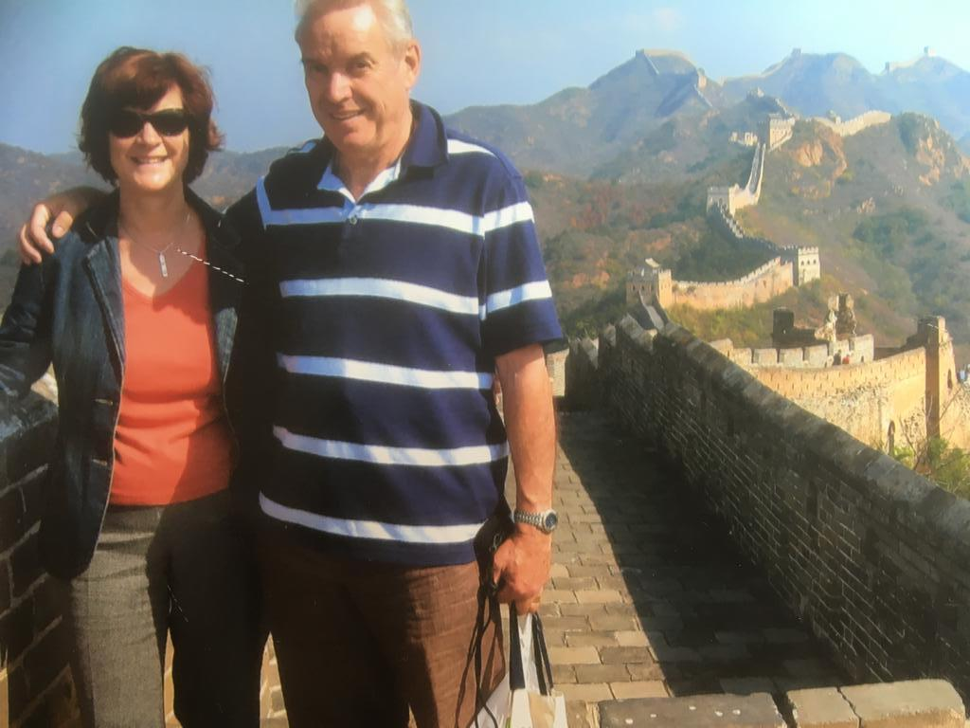
Great wall of china
It cannot be seen from the moon because they said it could 30 years before man went to space. They were proven wrong.
My grandparents went there in October 2008.
It’s the longest man made structure in the world. If you want to be precise it is 13,000 miles long according to the Chinese.
It is 6 to 7 metres tall.

Slide 5
Machu Picchu
Lisa Simpson went there in a episode because Bart put a tracker from his phone on a bird.
It’s a ruin of an ancient city in Peru.
The sun gate is a big attraction in Machu Picchu.
It was built by the Incas in the 15th century.

Slide 6
South Africa
The south Africa flag has the colours black green yellow blue red and white.
Animals can walk more freely then other places in the world.
Most of South Africa’s landscape is made up of high, flat areas called plateaus. These lands are covered with rolling grasslands, called highveld, and tree-dotted plains, called bushveld.
South Africa is bursting with wild life.

Slide 7
The Pyramids
The Egyptian pyramids are ancient pyramid-shaped masonry structures located in Egypt. ... Several of the Giza pyramids are counted among the largest structures ever built. The Pyramid of Khufu at Giza is the largest Egyptian pyramid. It is the only one of the Seven Wonders of the Ancient World still in existence.
The pyramids are the oldest 7th wonder of the world.
The oldest one was built in 2630 b.c.
The last pharaoh of the 4th Dynasty, Shepseskaf, did not build a pyramid and beginning in the 5th Dynasty, for various reasons, the massive scale and precision of construction decreased significantly leaving these later pyramids smaller, less well-built, and often hastily constructed.

Slide 8
The Ishtar gate
It was the door to the ancient city of Babylon
The Ishtar Gate was the eighth gate to the inner city of Babylon. It was constructed in about 575 BCE by order of King Nebuchadnezzar II on the north side of the city. It was part of a grand walled processional way leading into the city.
Ishtar. Ishtar, (Akkadian), Sumerian Inanna, in Mesopotamian religion, goddess of war and sexual love. Ishtar is the Akkadian counterpart of the West Semitic goddess Astarte.
Gilgamesh and Enkidu kill the Bull of Heaven after which the gods decide to sentence Enkidu to death and kill him. In the second half of the epic, distress over Enkidu's death causes Gilgamesh to undertake a long and perilous journey to discover the secret of eternal life.

Slide 9
Sydney opera house
The building is shaped to look like sails because it is on a platform positioned on the water.
The Sydney Opera House is a multi-venue performing arts centre at Sydney Harbour in Sydney, New South Wales, Australia. It is one of the 20th century's most famous and distinctive buildings.
The Sydney Opera House is one of the most-photographed buildings in the world, known for its unique use of a series of gleaming white sail-shaped shells as its roof structure. The iconic performing arts facility is Sydney's best-known landmark.
With nearly 2,500 seats and standing room for 1,000 people, the Teatro Colón stood as the world's largest opera house until the completion of the Sydney Opera House in 1973.

Slide 10
Sahara Desert
The Sahara is a desert located on the African continent. It is the largest hot desert in the world, and the third largest desert overall after Antarctica and the Arctic. Its area of 9,200,000 square kilometres is comparable to the area of China or the United States.
Sahara Desert is the largest desert in the world.
2.5 million people live in the Desert.
The most dangerous animals in the desert are: Gila Monster, Wild Dogs, Cougar, Inland Taipan, Ostrich, Western Diamondback Rattlesnake and Killer Bees

Slide 11
The Taj Mahal
The Taj Mahal is an ivory-white marble mausoleum on the southern bank of the river Yamuna in the Indian city of Agra. It was commissioned in 1632 by the Mughal emperor Shah Jahan to house the tomb of his favourite wife, Mumtaz Mahal; it also houses the tomb of Shah Jahan himself.
The building took 20 years to build.
Its worth 32 million rupees.
The royal Pavilion is built on the shape of this building.
It was built in 1632

Slide 12
The grand canyon
When the Simpsons visited the Grand Canyon Homer got tasered for mooning Bart on the glass sky bridge .
The Grand Canyon is in Arizona in the U.S.
The average amount of people who die in the Grand Canyon from falling is 17 a year

Slide 13
The Eiffel Tower
I built that
It was built in Paris in 1887.
It took 2 years, 2 months and 5 days to build.
It was designed by Gustave Eiffel.
Its 984 feet tall and 328 feet wide at the base.
Homer has been to the Eiffel Tower but not with the family.

Slide 14
Antarctica
The South Pole is found in Antarctica
Most of Antarctica is covered in ice over 1.6 kilometres thick
Antarctica holds most of the world's fresh water
Antarctica is a desert
No human can stay in Antarctica permanently but 5000 people have lived there before

Slide 15
The Statue Of Liberty
And I built a bit of this too
It was built on Liberty Island in New York Harbour finished in 1886
It is 93 metres tall and it is 10.7 metres in width
It was a gift from the French to the Americans
When Homer Simpson was part of the bee sharps he performed in front of the Statue Of Liberty

Slide 16
Canada
In 2012 the population of Canada was around 35 million
The capital city of Canada is Ottawa
The 2 main languages spoken in Canada are English and French
Canada is the second largest country in the world by total area (Russia is the largest)

Slide 17
Mount Vesuvius
It is stratovolcano because it is built up from layers from explosions and lava
In AD79 it erupted and killed 2000 people in the nearby town of Pompeii
You can get a ticket to the top of it there’s still a chance it will erupt
Its in Italy and last erupted in march 1944 in WWII

Slide 18
germany
The name for Germany in the German language is Deutschland
The population of Germany was around 82 million in 2010
The capital of Germany is Berlin
65% of the highways in Germany have no speed limit

Slide 19
Big ben
Big Ben could also of been named sir Benjamin
YOU CAN HEAR IT FROM 5 MILES AWAY!
It has a big bell in it and it dings every 15 minutes
Big Ben is the name of the bell inside. The tower is named Elizabeth tower
The bell in big ben weighs 15.1 tons

Slide 20
Park guell
Park Guell is in Barcelona in Spain
It was designed by Antoni Gaudi. He was an Artist
Its all free except one zone but its not worth it
9 million people go there a year

Slide 21
Leaning tower of Pisa
hello
The tower is leaning because the soft ground could not properly support the tower
It leans at a 5.5 degrees angle and should stay up for 200 hundred years or more
Bonanno Pisano built the tower on August 1173
It was built in Italy

Slide 22
Thank you for looking at louis’ places around the world
yay
yay
Bye!
yay

